Slide 1




Basketball Team Manager
A Python application based on Object-Oriented Programming (OOP) principles.

Slide 2


BACKGROUND
This application was inspired by my personal experience playing basketball, where I realized the importance of recording and managing team information in a more structured way. I often forgot players' or coaches' details during training or matches. Therefore, I developed a simple application to help record player names, positions, jersey numbers, and coach information. Using an OOP approach and a GUI interface, this app is designed to be user-friendly and efficient.

Slide 3
Application Features
Add Player Data
Add Coach Data
View Team Roster
Input player name, age, jersey number, and position.
Enter coach name, age, and experience level.
Access full team details via a modern GUI.

Slide 4
OOP Code Structure
Abstract Class: Person
Inheritance
Defines common attributes like name and age.
Player and Coach classes inherit from Person.
Polymorphism
Team Class
show_info() method implemented uniquely
in each class.
Manages the entire list of players and the coach.
.

Slide 5

Data Storage
Automatic Management
All team data is stored in a team.json file.
Includes team name, coach details, and player list.
JSON Format
Data loads and saves automatically with app runs or changes.

Slide 6
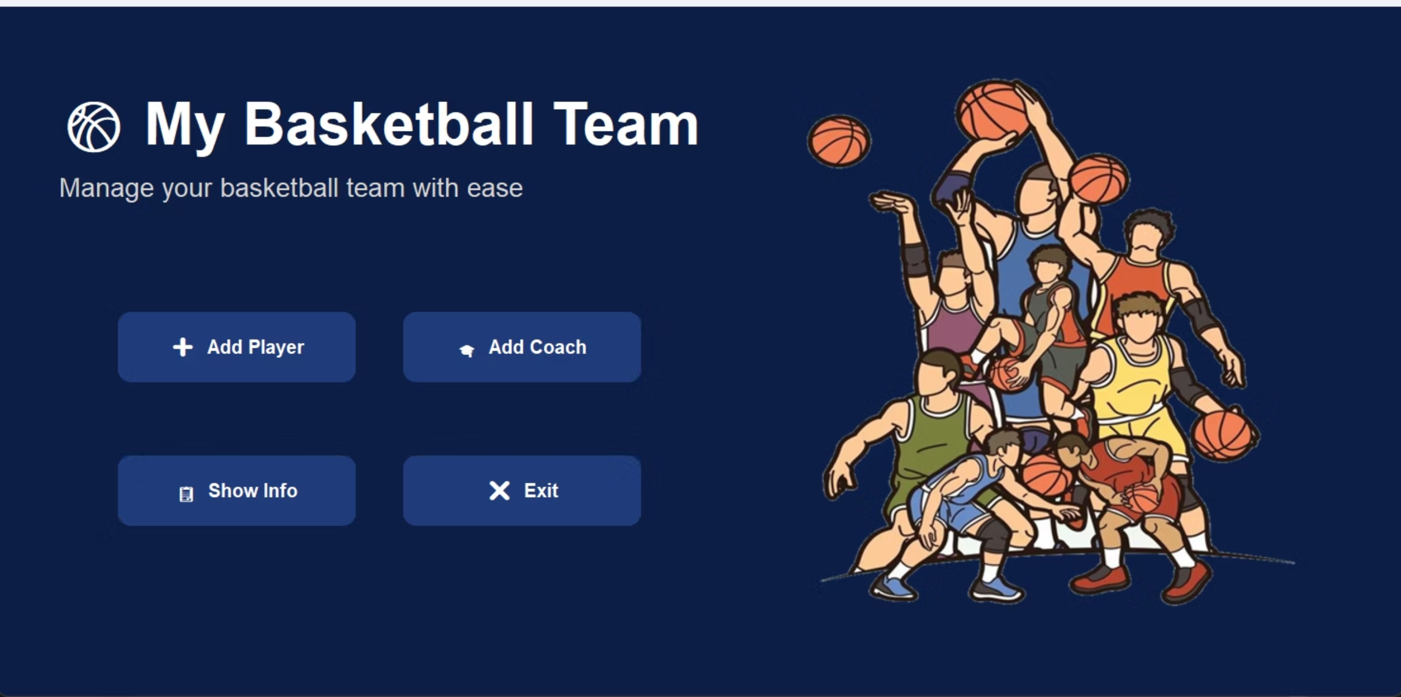
Application Interface
The application features a modern and intuitive graphical user interface (GUI) built with customtkinter, ensuring ease of use for team management tasks.

Slide 7
How to Run the Application
01
02
03
04
Install Python 3
Run Command
Navigate to Folder
Manage Data

Slide 8
Closing
With this application, I can manage basketball team data more easily and efficiently. This project also serves as a way to apply OOP concepts in a real-world scenario, from inheritance, abstract classes, to polymorphism, while integrating data storage using JSON. Thank you for your attention. I am ready to answer any questions you may have.

